Slide 1
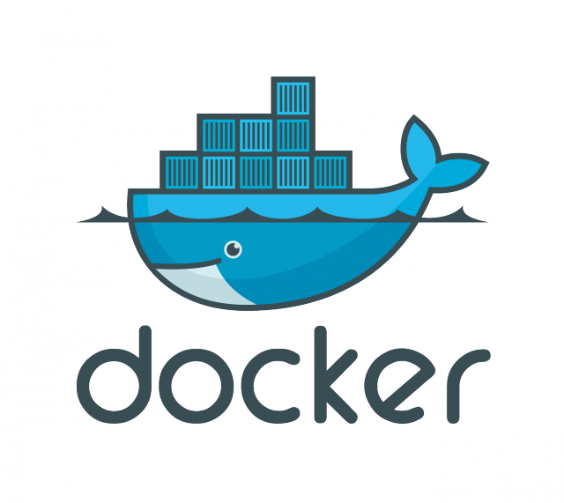
Introduction to Docker
Stav Alfi

Slide 2
Pre Requirements
Basic knowledge about what is a Git, compilation, unit tests, CI (Continuous integration) and CD (continuous deployment), virtual machines, cluster

Slide 3
Agenda
Docker engine
Docker image
Docker repository
Docker registry
Docker container
Dockerfile
Docker service & stack
Swarm
Demo: Continuous deployment ☺

Slide 4
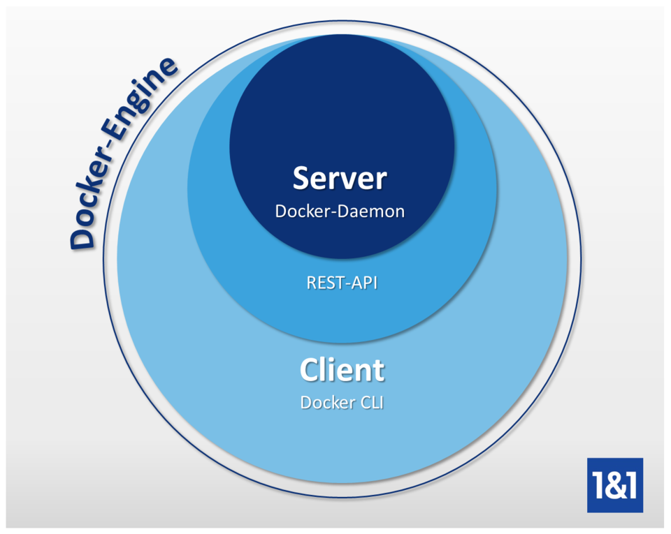
Docker engine

Slide 5
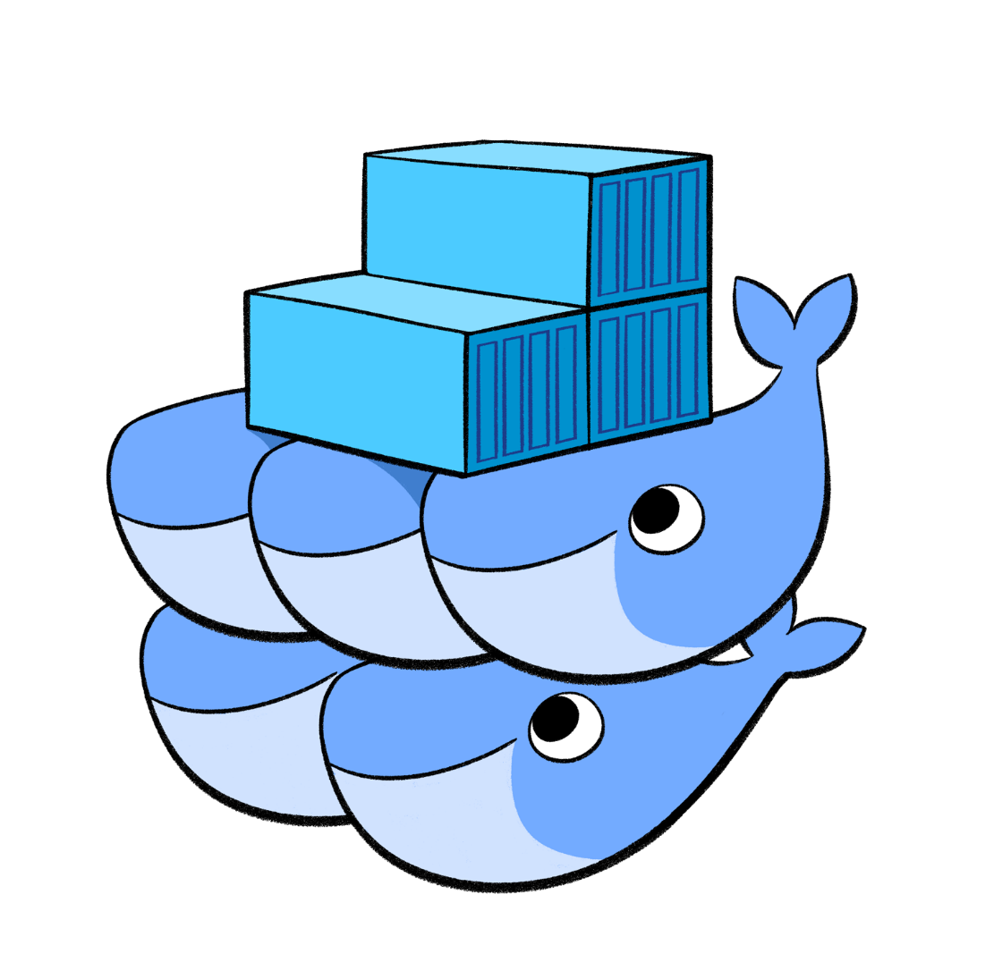
Docker image

Slide 6

Docker repository

Slide 7

Docker registry

Slide 8
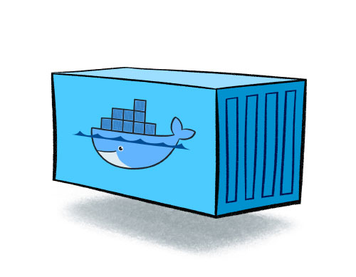
Docker container

Slide 9
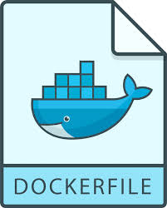
Dockerfile

Slide 10
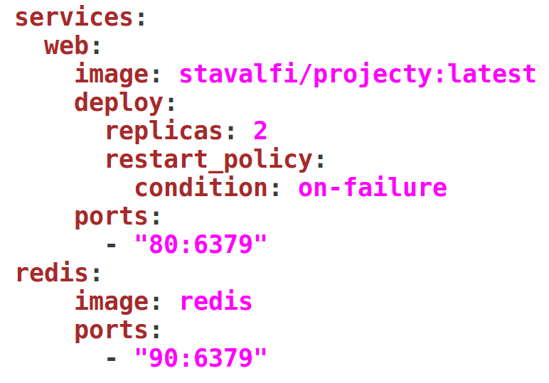
Docker service & stack

Slide 11
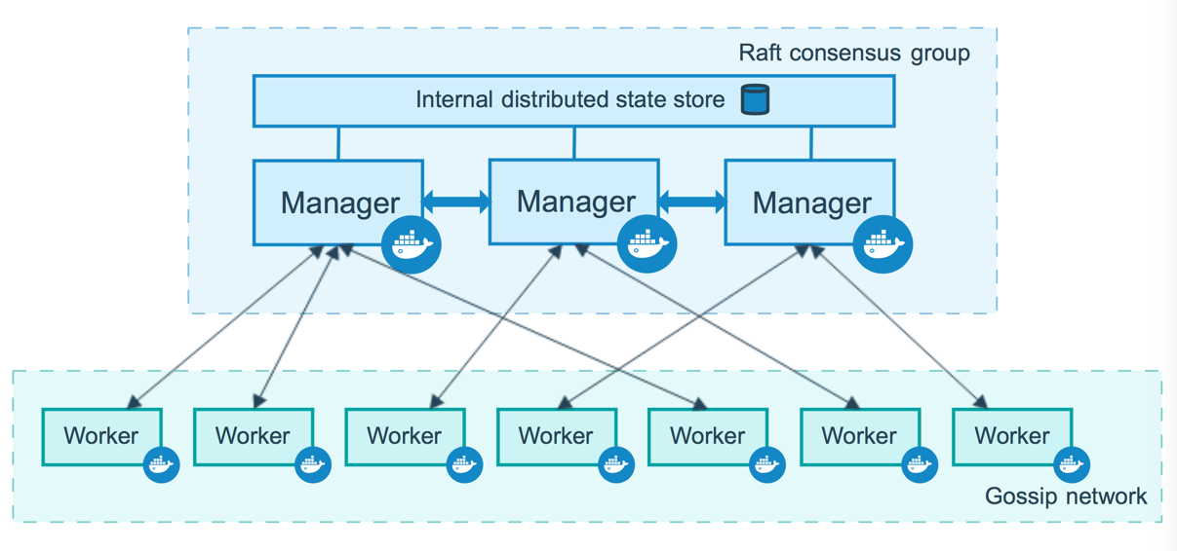
Swarm

Slide 12
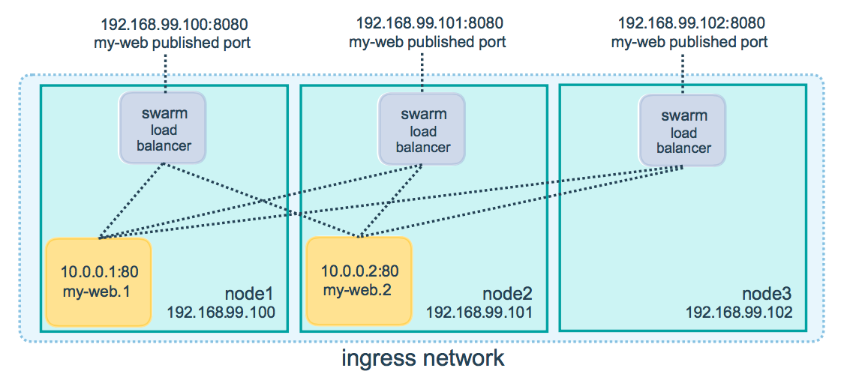
Swarm

Slide 13
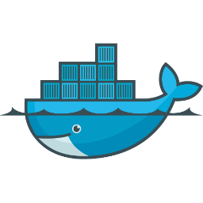


Continuous Deployment

